Slide 2
RFPs: Turning ‘Nah’ Into Heck ‘Yeah!’
Maurice Harary
The Bid Lab | Bid Banana
Coffee Sponsor

Slide 3
Welcome & Thank You to Our Sponsors
Coffee Sponsor
Audio Visual Sponsor
Coffee Sponsor

Slide 4
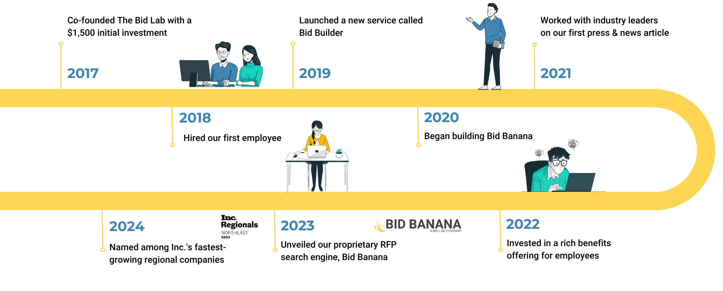
Maurice’s Story
Notes:
Maurice Harary had a successful career securing multi-million dollar deals for global corporations, but felt unfulfilled. After collaborating on an RFP with his wife, Jordan, they realized their combined skills could help small businesses. Maurice left his corporate job, and The Bid Lab was born.
From the early days of The Bid Lab, Maurice and Jordan poured their hearts into each project and gradually grew their bootstrapped remote startup into a thriving organization.
Today, with 20 employees, 2 daughters and a dog in tow, The Bid Lab has become much more than a business. Family was and remains the bedrock of The business. As a niche small business here to support other small businesses, they know from personal experience the rewards of taking the right risks. And, more importantly, they learned firsthand that the right partnership can make a world of difference.

Slide 5
Sales Proposals 101
Find the Right Opportunity
Stand Out From the Crowd
Leverage Technology
Build a Portfolio

Slide 6
Find the Right Opportunity
What kind of proposal opportunity is right for your organization? Do a little research and learn about solicitation and response trends within your business sector. Look for online resource hubs (like our own Learning Center!), LinkedIn interest groups, or how-to industry webinars.
Who
What
Where
When
Why
Determine your target demographic in your region, learn what they need, and develop your marketing strategies accordingly.
Make sure you’re qualified to supply the requested products and services at the size and scale that your target requires.
Continue checking relevant industry, company, or government procurement hubs for new opportunities.
Estimate whether you can accomplish the scope of work within a reasonable timeframe, under budget, and within regulatory constraints.
Ask yourself why your target would choose your business, then build on that answer in your proposal’s executive summary.

Slide 7
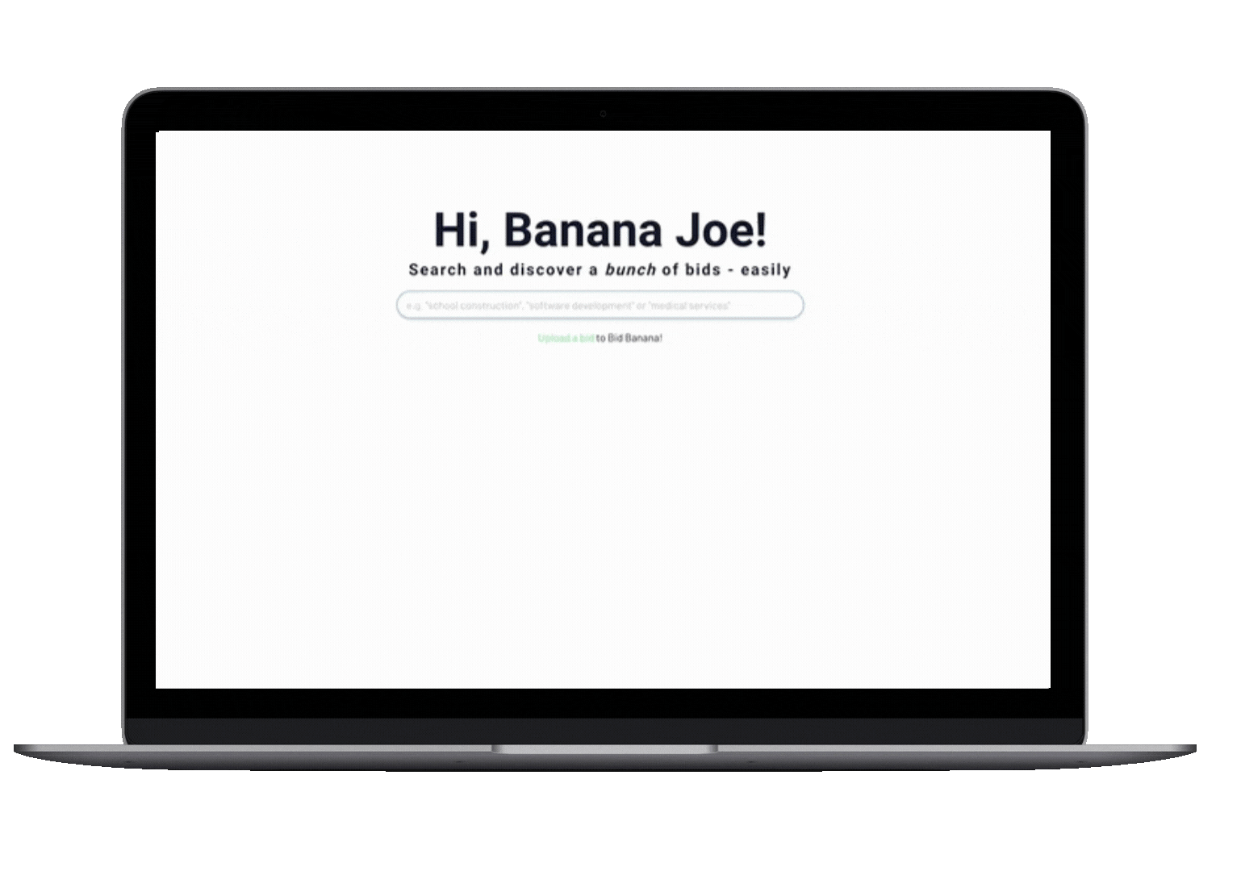
My clients use
Bid Banana
to find opportunities

Slide 8
Tell Your Story in Your Bid
Company Background:
Introduce yourself. Briefly explain who you are, how you started, your company’s mission and values, then end with the reasons why your products/services are the best fit for the job. This is the cornerstone of what will be your executive summary, so don’t clutter it up with fluffy jargon and irrelevant content.
Contact and Qualifications Table:
Make sure they can reach you. Include the company’s name as well as any required basic information about the organization. Make sure to include the name, title, phone, and email of your company’s designated point of contact.
References and/or Case Studies:
You’ve managed deals like this before. Include references and case studies for past projects you’ve completed for others in the same area or industry. Include information about the scope of work and any outcomes.

Slide 9
Use Your Resources
Yes, use your favorite generative AI tool to brainstorm new ideas, but we don’t advise generating your responses outright. While it’s tempting to let AI generate your document for you, keep in mind that it’s also tempting for everyone else. If too many submissions are using the same structure, language, tone, and word choices, then the winner will almost always be the one that sounds the most human. If you do choose to use AI, make sure a human reviews your content before you submit!
Your Team
Your Technology
Your Time
From finding strategic bids to helping grow business to writing, editing, fact-checking, and designing winning proposals, a well-structured sales proposal management team can be the key to building a winning bid.
Use your tech to your advantage. Learn how to work from a cloud-based office suite for accessibility, use proofreaders and spell-checkers to catch typos and errors, and build branded infographics with time-saving design tools.
If you’re racing the clock to develop a half-baked proposal at the last minute, then it’s unlikely you’ll close the deal. Your time is just as much of a resource as your team and tech– so don’t waste it! Use it productively.

Slide 10
Build Your Portfolio
Create a repository for future sales proposals with frequently used, pre-existing content by building a content portfolio. Win or lose your sales proposal, remember: great content is an investment on its own.
Assemble a Variety of On-hand Materials
Curate and File New Content for the Future
Save Fresh Variations of Pre-existing Content
Develop a System of Organization
Keep It Updated and Focused

Slide 11
Thank you for joining us
The first 50 people to email me at respond@thebidlab.com
get absolutely FREE….
Access to the Learning Center
7-Day Free Trial of Bid Banana
Free Consultation
Free Cover Letter Template

Slide 12
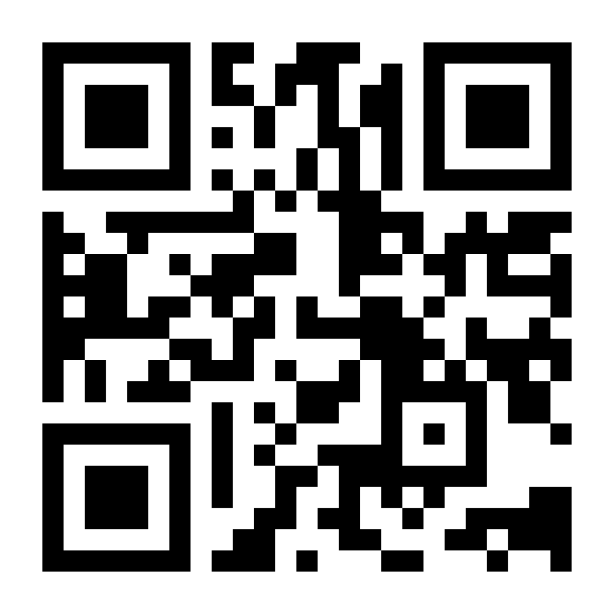
Stay in Touch
https://www.linkedin.com/company/the-bid-lab/
https://www.facebook.com/thebidlab/
@thebidlab
www.thebidlab.com
Visit Our Website

Slide 13
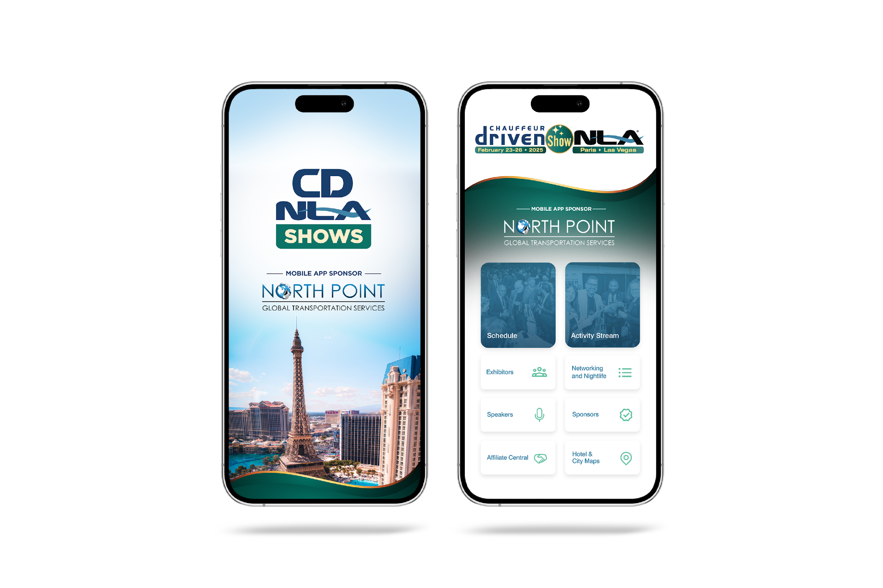
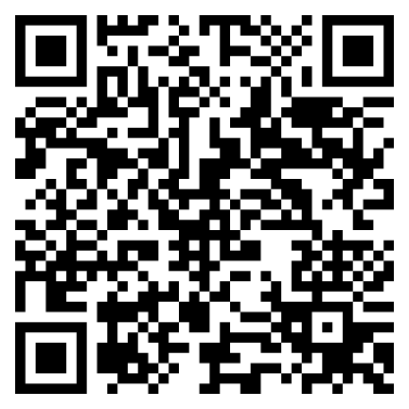
Let Us Know How
We Did!
Fill Out the Survey!

Slide 14
Thank You for Joining Us!

